Slide 1
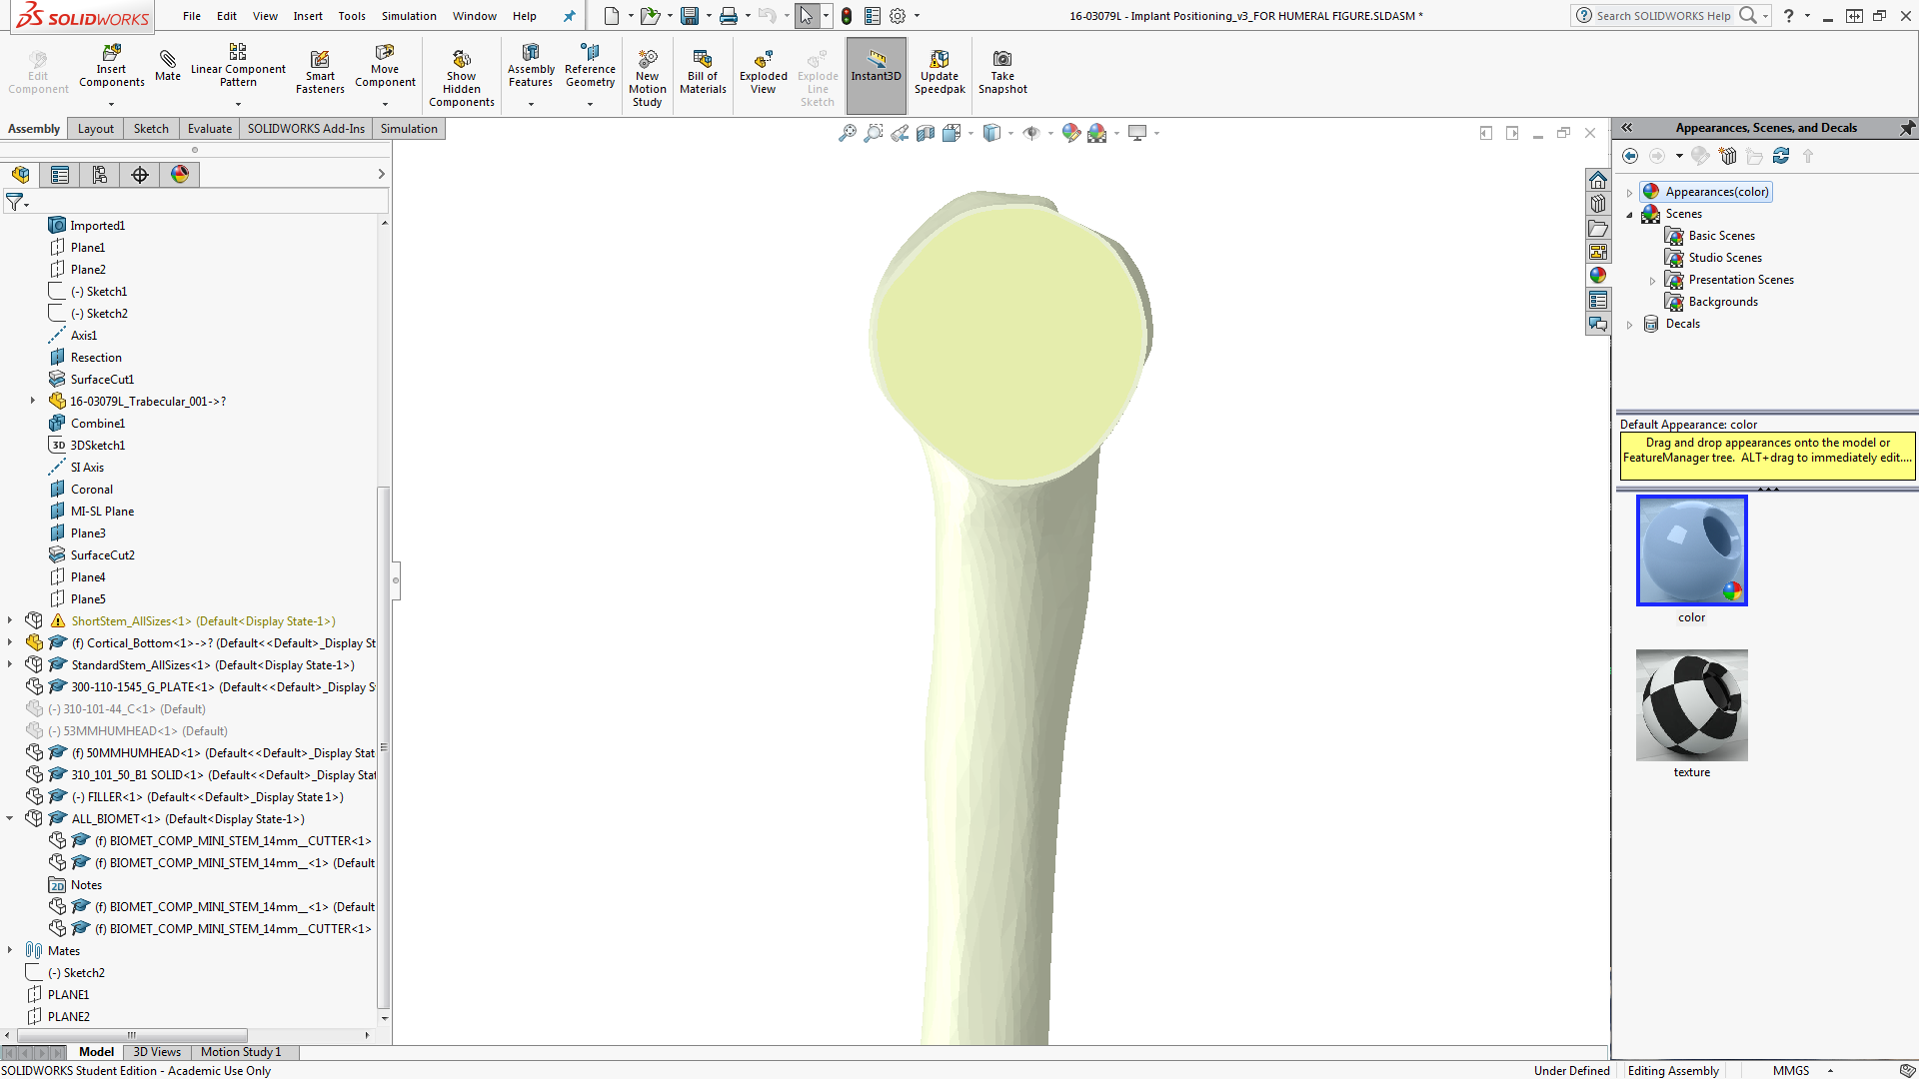
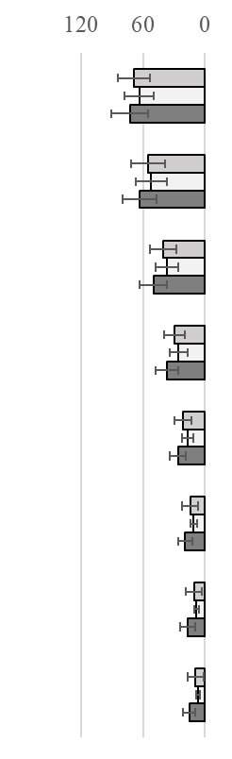
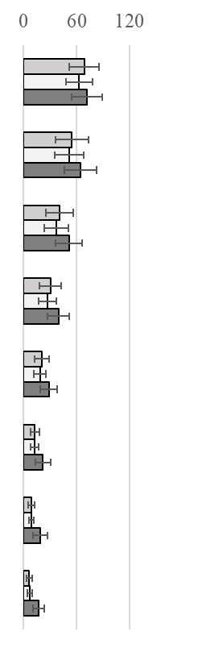
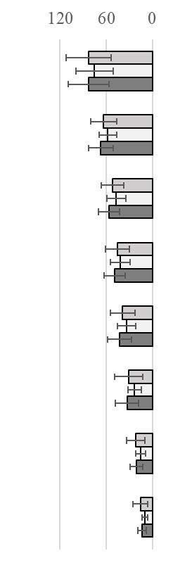
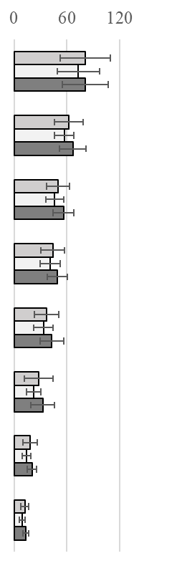
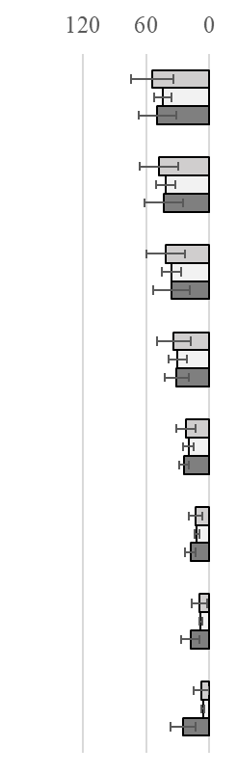
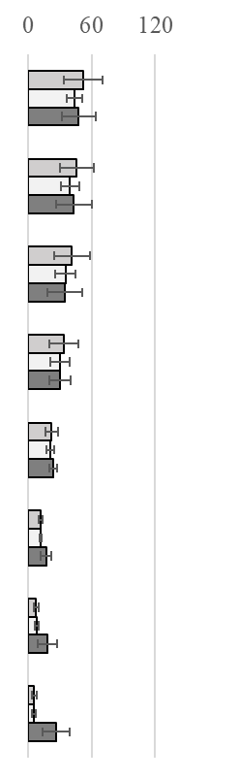
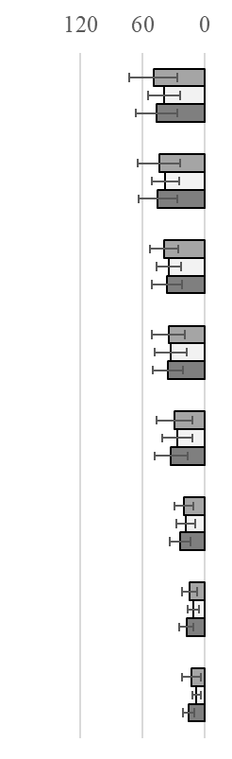
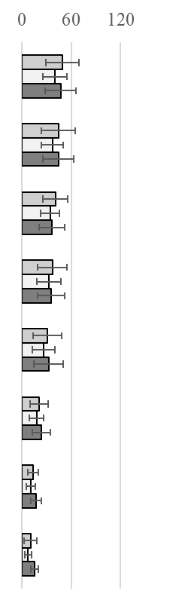
Posterior
Lateral
Cortical Bone
Medial
Anterior
45˚ Abduction 75˚ Abduction
45˚ Abduction 75˚ Abduction
45˚ Abduction 75˚ Abduction
45˚ Abduction 75˚ Abduction
Von Mises of the Change in Stress (%)
Von Mises of the Change in Stress (%)
Von Mises of the Change in Stress (%)
Von Mises of the Change in Stress (%)
0-5
5-10
10-15
15-20
20-25
25-30
30-35
35-40
0-5
5-10
10-15
15-20
20-25
25-30
30-35
35-40
L
0-5
5-10
10-15
15-20
20-25
25-30
30-35
35-40
0-5
5-10
10-15
15-20
20-25
25-30
30-35
35-40
P
A
*
*
*
*
*
*
*
*
*
*
*
*
*
*
*
*
M
*
*
*
*
*
*
*
Depth from Cut Plane (mm)
*
*
Depth from Cut Plane (mm)
*
*
*
*
*
*
*
*
*
*
*
*
*
*
*
*
*
VAR
*
*
*
*
*
STD
*
*
*
*
*
VAL
p<0.05
*
*
*
*
*
*
*
*
*
*
*
*

Slide 2
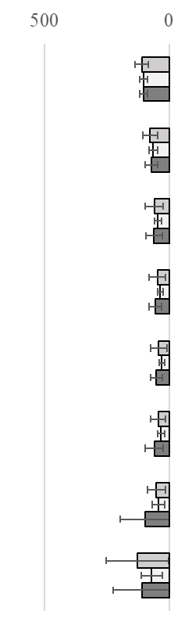
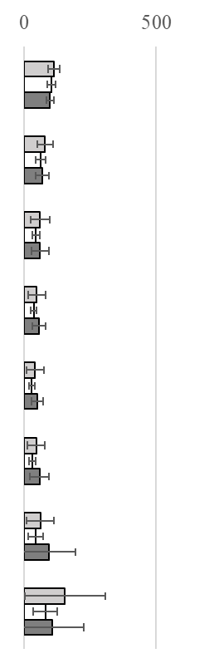
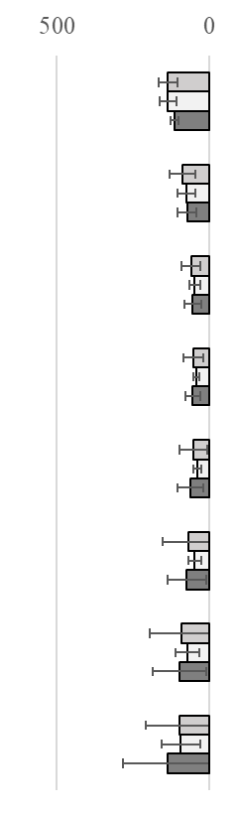
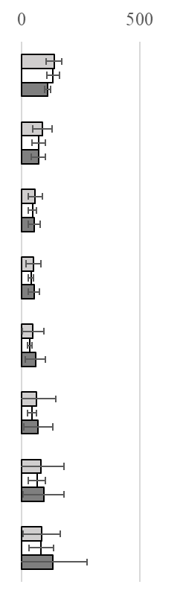
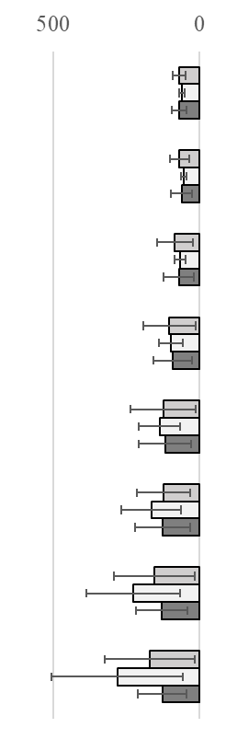
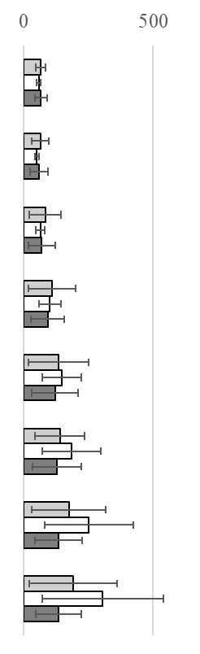
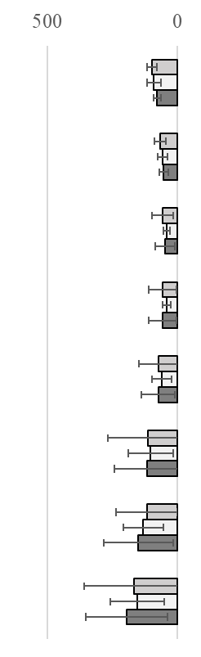
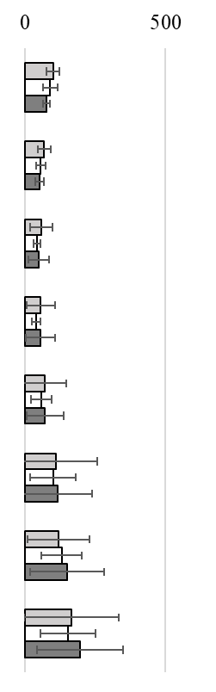
Posterior
Lateral
Trabecular Bone
Medial
Anterior
45˚ Abduction 75˚ Abduction
45˚ Abduction 75˚ Abduction
45˚ Abduction 75˚ Abduction
45˚ Abduction 75˚ Abduction
Von Mises of the Change in Stress (%)
Von Mises of the Change in Stress (%)
Von Mises of the Change in Stress (%)
Von Mises of the Change in Stress (%)
0-5
5-10
10-15
15-20
20-25
25-30
30-35
35-40
0-5
5-10
10-15
15-20
20-25
25-30
30-35
35-40
L
0-5
5-10
10-15
15-20
20-25
25-30
30-35
35-40
0-5
5-10
10-15
15-20
20-25
25-30
30-35
35-40
*
*
*
*
*
*
P
A
*
*
*
M
*
*
*
*
*
Depth from Cut Plane (mm)
Depth from Cut Plane (mm)
*
*
*
*
VAR
STD
*
*
*
VAL
p<0.05
*
*
*

Slide 3
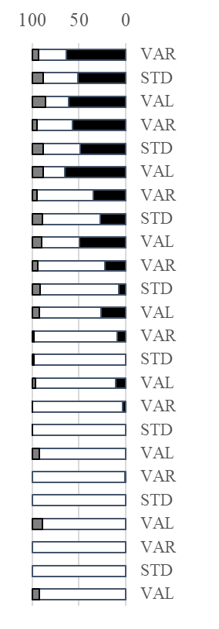
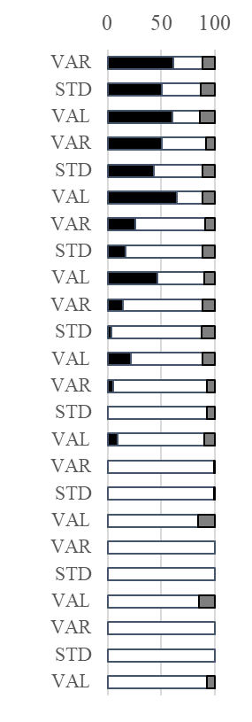
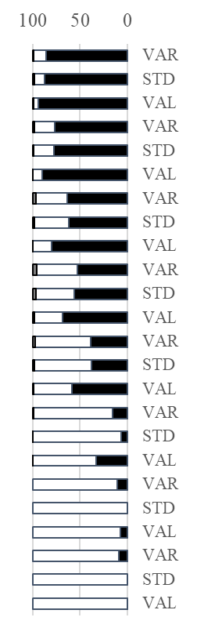
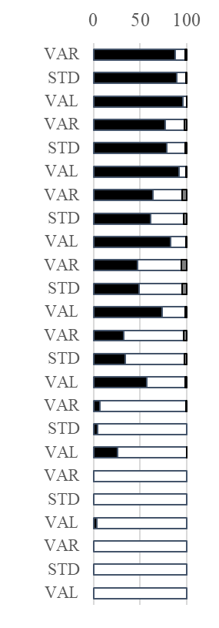
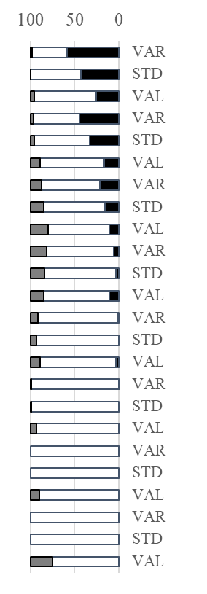
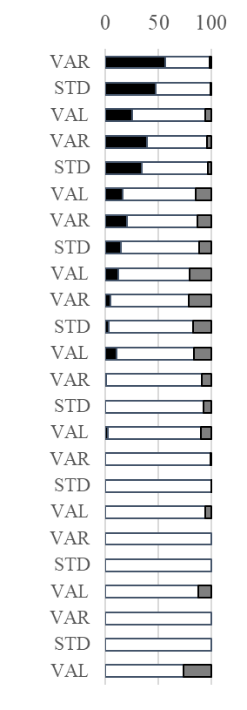
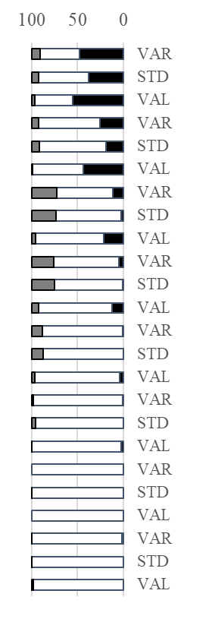
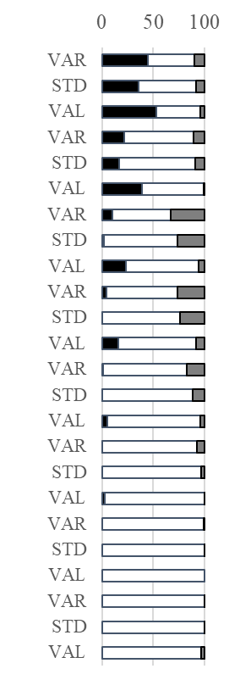
Posterior
Lateral
Cortical Bone
Medial
Anterior
45˚ Abduction 75˚ Abduction
45˚ Abduction 75˚ Abduction
45˚ Abduction 75˚ Abduction
45˚ Abduction 75˚ Abduction
Slice Volume (%)
Slice Volume (%)
Slice Volume (%)
Slice Volume (%)
L
0-5
5-10
10-15
15-20
20-25
25-30
30-35
35-40
0-5
5-10
10-15
15-20
20-25
25-30
30-35
35-40
*
0-5
5-10
10-15
15-20
20-25
25-30
30-35
35-40
0-5
5-10
10-15
15-20
20-25
25-30
30-35
35-40
*
*
*
*
*
*
*
*
*
*
*
P
A
*
*
*
*
*
*
*
*
*
*
*
*
*
*
*
M
*
*
*
*
*
*
*
*
*
*
*
*
*
*
*
p<0.05
*
Depth from Cut Plane (mm)
Depth from Cut Plane (mm)
Depth from Cut Plane (mm)
Depth from Cut Plane (mm)

Slide 4
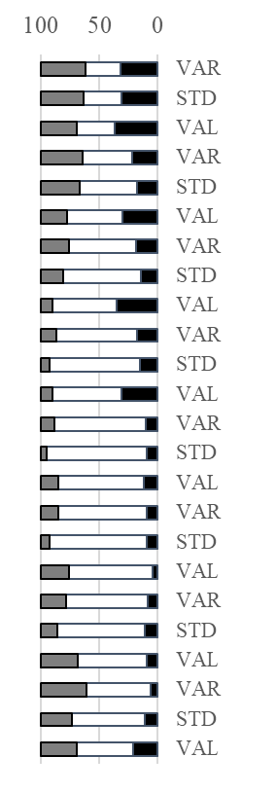
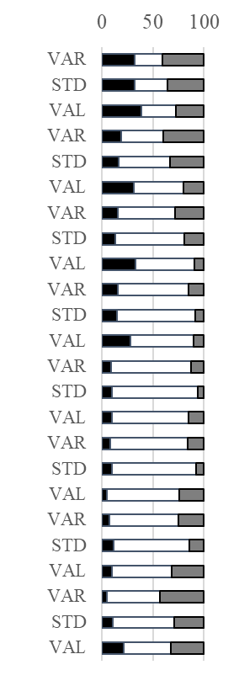
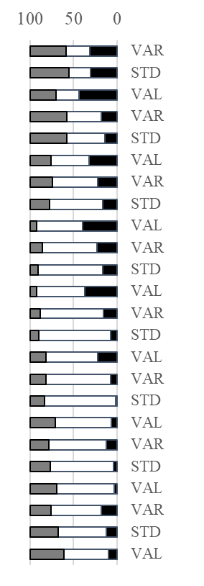
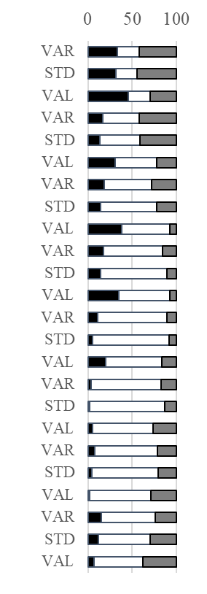
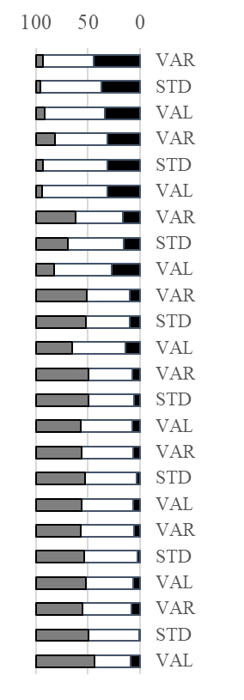
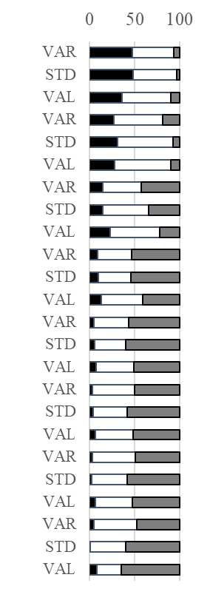
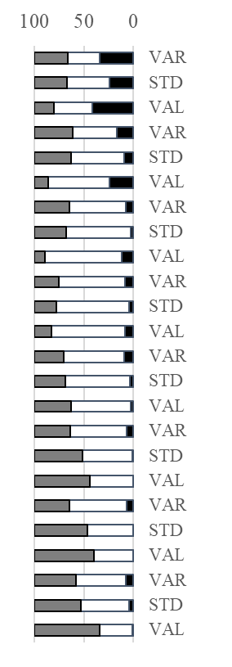
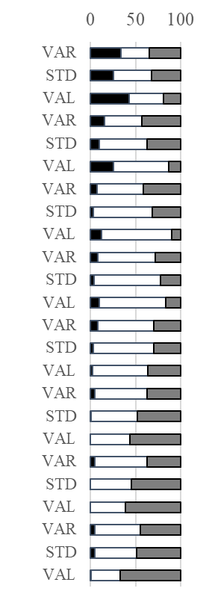
Posterior
Lateral
Trabecular Bone
Medial
Anterior
45˚ Abduction 75˚ Abduction
45˚ Abduction 75˚ Abduction
45˚ Abduction 75˚ Abduction
45˚ Abduction 75˚ Abduction
Slice Volume (%)
Slice Volume (%)
Slice Volume (%)
Slice Volume (%)
L
0-5
5-10
10-15
15-20
20-25
25-30
30-35
35-40
0-5
5-10
10-15
15-20
20-25
25-30
30-35
35-40
0-5
5-10
10-15
15-20
20-25
25-30
30-35
35-40
0-5
5-10
10-15
15-20
20-25
25-30
30-35
35-40
*
*
*
*
*
*
*
*
*
*
*
*
*
P
A
*
*
*
*
*
*
*
*
*
*
*
*
*
*
*
*
*
*
M
*
*
*
*
*
*
*
*
*
*
*
*
*
*
*
*
*
*
*
p<0.05
*
*
*
*
*
*
*
*
*
*
*
*
*
*
Depth from Cut Plane (mm)
Depth from Cut Plane (mm)
Depth from Cut Plane (mm)
Depth from Cut Plane (mm)

Slide 5
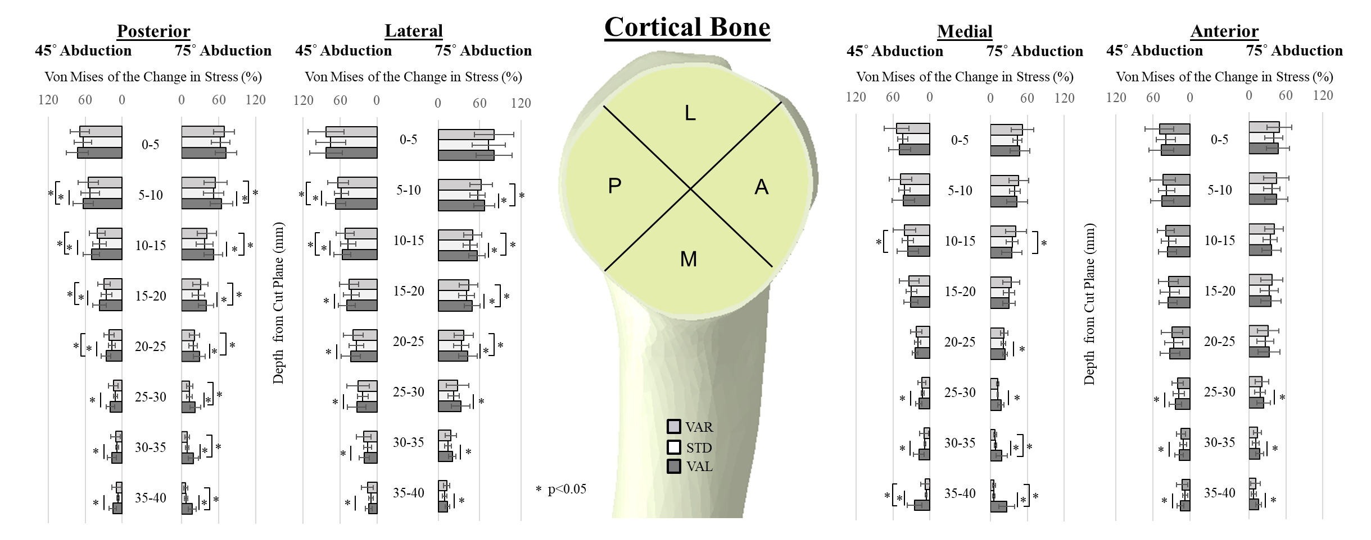
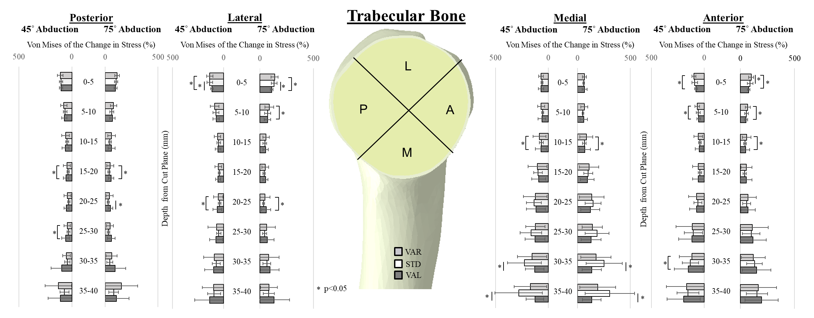

Slide 6
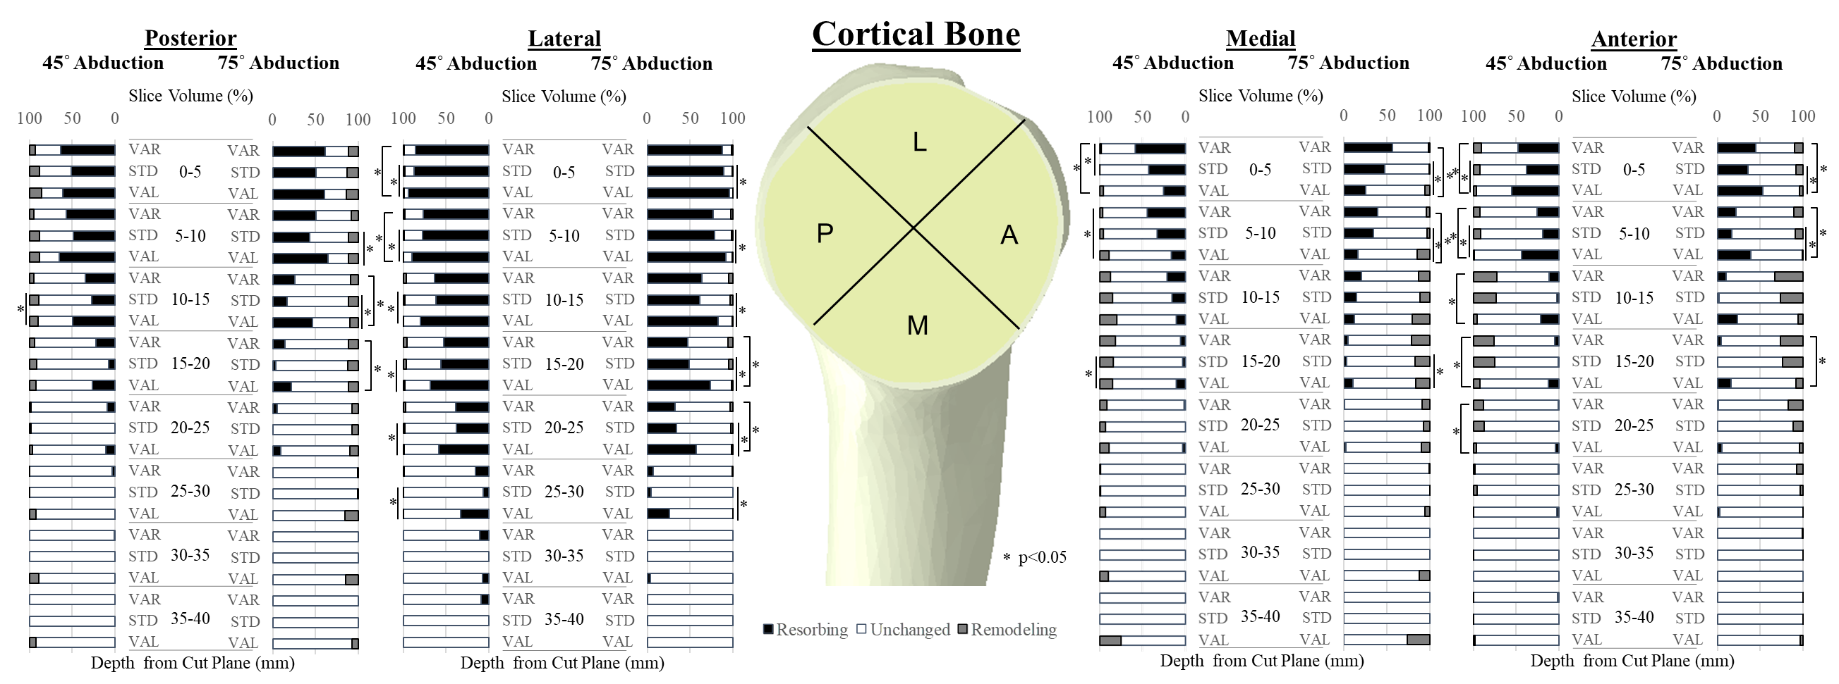
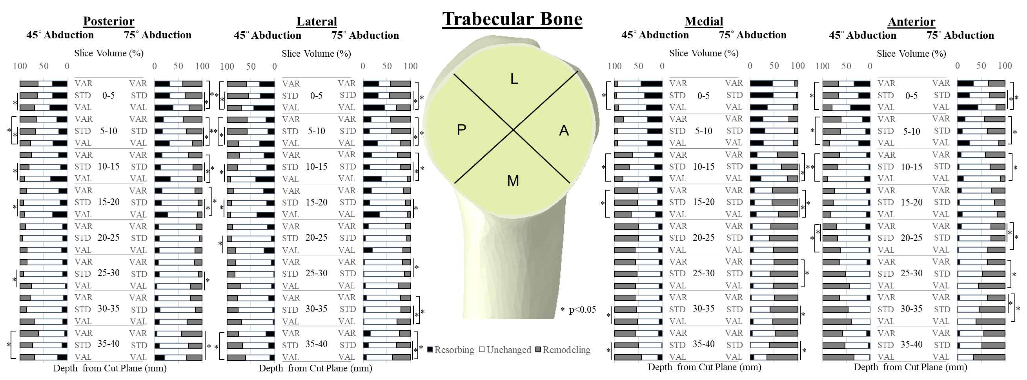

Slide 7
*
*
*
*
*
*
*
*
*
*
*
*
*

